Slide 1
Understanding the
Child File
National Child Abuse
and
Neglect Data System
(NCANDS)
NCANDS Case Level Data

Slide 2
Today’s Topics
Child File Overview
The Child File Process
Reports/Records/Unique Identifiers
Child File Entities
Data Record Layout
Units of Analysis and Counting
State Data Validation
The Mapping Process

Slide 3
Recall the Agency Data File
Aggregate Totals Only
Preventive Services
Screened Out Reports
Out of Court Contacts
Child Maltreatments Fatalities
CPS Work Force

Slide 4
Child File Data
Detailed Data by Case
Reports
Children Subject of Investigation
Child Maltreatments and Child Fatalities
Child and Caretaker Risk Factors
Services Provided
Staff
Perpetrators

Slide 5
NCANDS Data Collection Process
State Receives Guidelines
State Data Submission
State Mapping Process
State Submission of Year’s Final Data Set
NCANDS Analyses of Data Submission
Technical Assistance and Map Review
NCANDS Processing of Year’s Final Data Sets
Technical Assistance and Review of Data
NCANDS Yearly Analyses

Slide 6
Guidelines and Procedures for Submitting Data to NCANDS
Completing Mapping Forms
Constructing and Validating the Child File
Submitting the Child File and Agency File
Detailed Information on:
  NCANDS Mapping Forms
  Record Layout and Codes
  Glossary

Slide 7
Unique Identifiers
Does Your State Have Them?
A Unique Report ID never has and never will be used for another report, even in subsequent years. The ID will always be the only ID used to reference this given report.

Slide 8
Unique Identifiers (con’t.)
A Unique Child ID never has and never will be used for another child. The ID will always be the only ID used to reference this child. If this child appears in a later report, this ID must be used again for this child, even in subsequent years.

Slide 9
Unique Identifiers (con’t.)
A Unique Worker ID never has and never will be used for another worker. The ID will always be the only ID used to reference this worker. If this worker appears in a later report, this ID must be used again for this worker, even in subsequent years.

Slide 10
Unique Identifiers (con’t.)
A Unique Perpetrator ID never has and never will be used for another perpetrator. The ID will always be the only ID used to reference this perpetrator. If this perpetrator appears in a later report, this ID must be used again for this perpetrator, even in subsequent years.

Slide 11
Non-Unique Identifiers
If Your State Cannot Provide Unique Identifiers ...
The analytical use of your State’s data may be somewhat restricted.
Your NCANDS Liaison will help you to assess your ID environment during the Mapping Process.

Slide 12
Special Identifier Restrictions
A State’s Report/Child/Staff/Perpetrator IDs ...
Should be modified prior to appearing in the Child File data file to insure confidentiality.
Some States have determined their identifiers to be sufficiently confidential without modification.

Slide 13
Some Child File Definitions
A Child File ...
Is a collection of Reports from a State for a given Data Submission Year
Is an ASCII (text) file
Should be sorted by Child ID within Report ID

Slide 14
Some Child File Report Definitions
A Child File Report ...
Is a notification of suspected child abuse
May be Substantiated, Unsubstantiated, Alternative Response, or Other Dispositions
May involve one or more children
May involve one or more alleged perpetrators

Slide 15
Some Child Record Definitions
A Child File Record contains…
Data related to only one child in a single given report
Data for victims and non-victims
Data in all fields, if State can provide
Contains data concerning perpetrators (up to three) for the child

Slide 16
So . . .
A Report involving three Children will result in three data records being submitted

Slide 17
Child File Entity Relationships
A report can pertain to more than one child.
Child
1
Report
A
Child
2

Slide 18
Child File Entity Relationships (con’t.)
Physically Abused
Perpetrator
A
Report
A
Sexually Abused
Perpetrator
A
Child
1
Physically Abused
Perpetrator
B
Report
B
A child can be the subject of more than one report.
Perpetrator
A
Neglected
Perpetrator
C

Slide 19
Child File Entity Relationships (con’t.)
A perpetrator can be associated with more than one report and more than one child in a report.
Child
1
Report
A
Child
2
Perpetrator
A
Child
2
Report
B
Child
3

Slide 20
Data Element Categories
Report Data
Child Data
  Child Demographics
  Child Maltreatments
  Child Risks
  Caretaker Risks
  Services Provided
Staff Data
Perpetrators Data

Slide 21
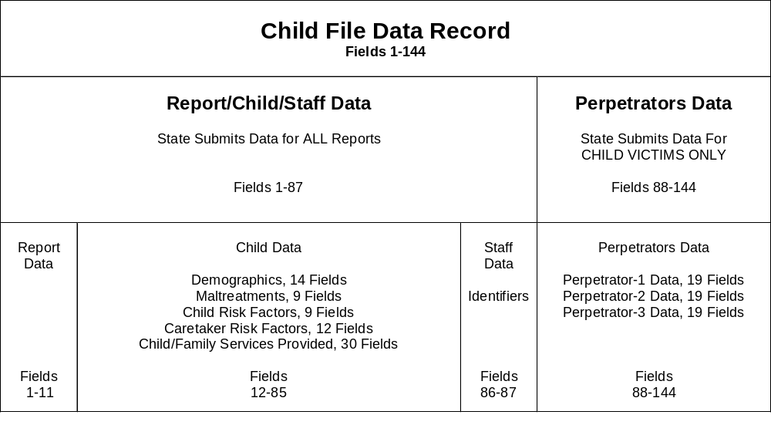
Child Record Layout

Slide 22
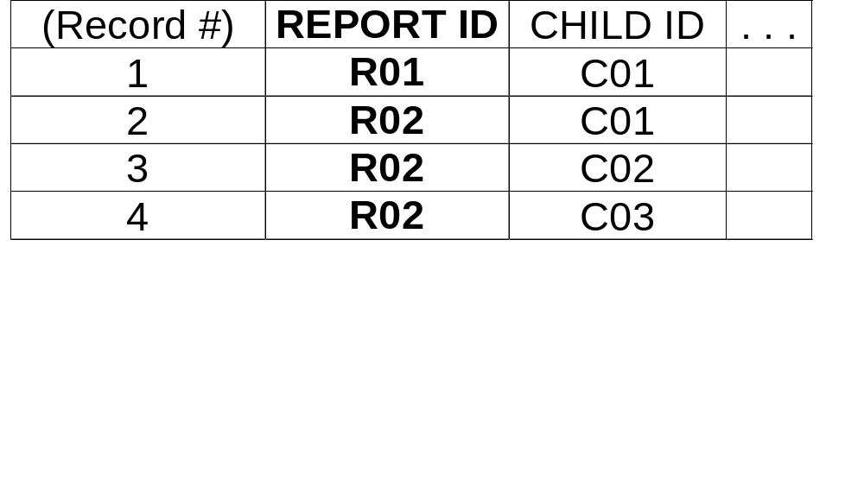
What Makes A Unique Record?
A Report ID alone does not make a Child record unique.

Slide 23
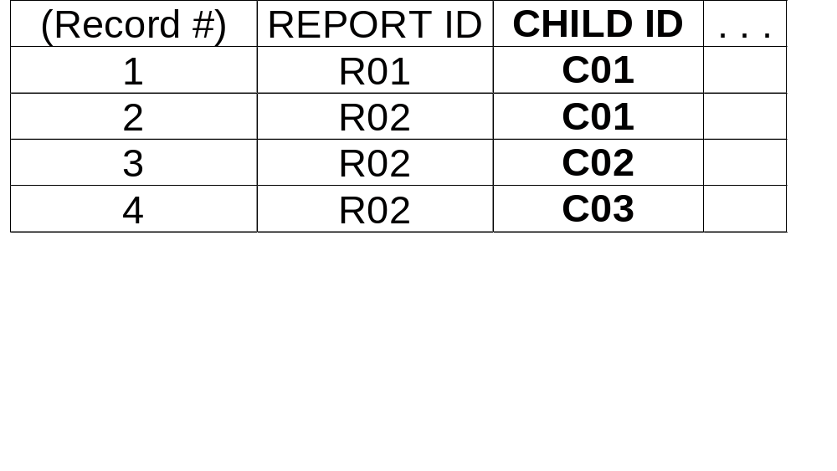
What Makes A Unique Record?
A Child ID alone does not make a Child record unique.

Slide 24
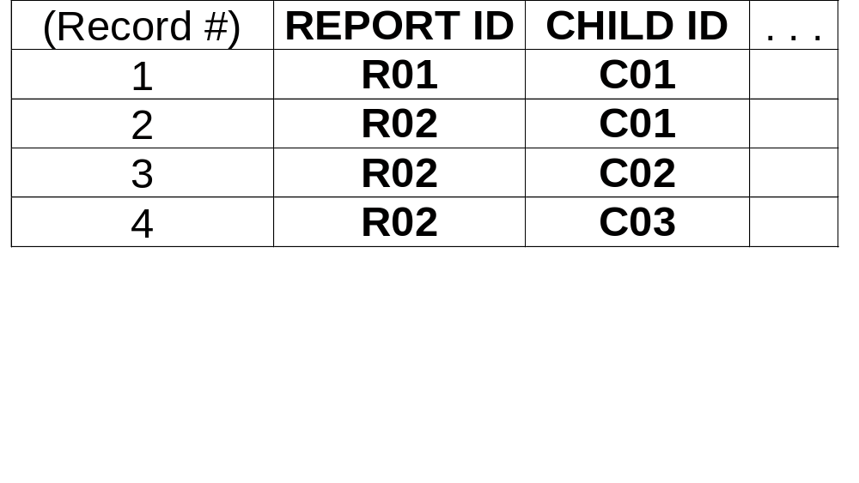
The Report ID and the Child ID
The Report ID and the Child ID together do make a Child record unique.
A record is then called a Report-Child Pair or
an RC Pair

Slide 25
Child Maltreatments
Four Possible Maltreatments or Alleged Maltreatments per Child
No order to the Maltreatments, but State should report the most significant
Any Maltreatment Type can occur in any of the four Maltreatment areas
No Maltreatment can be duplicated in a single Child record

Slide 26
Child Maltreatment Levels
Each of the four Child Maltreatments in a single record has a Maltreatment Level
Substantiated (S)
Indicated (S)
AR-Victim (AV)
AR-Non-Victim (AN)
Unsubstantiated (U)
other codes . . . (U)
  Note: “Indicated” treated as “Substantiated.”

Slide 27
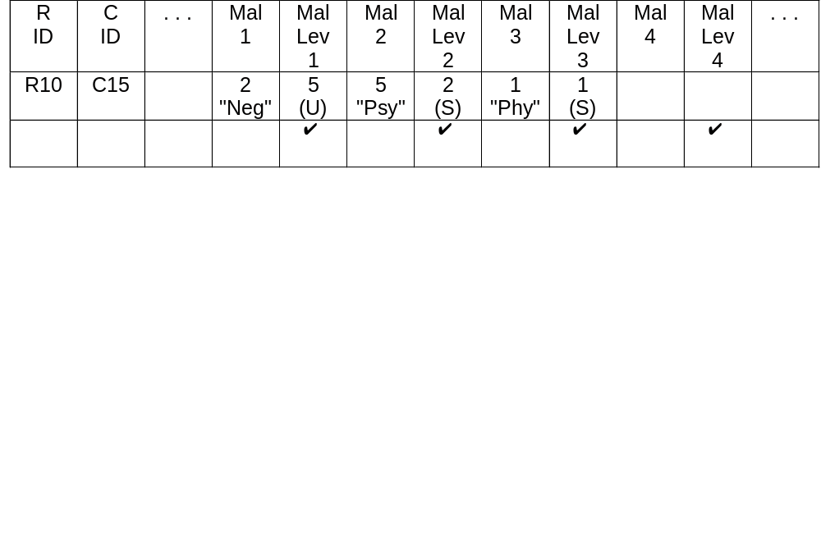
Maltreatment Example
Each Maltreatment has a Level
Maltreatment 1, Neglect, was Unsub.
Maltreatment 2, Psychological, was Sub.
Maltreatment 3, Physical, was Sub.

Slide 28
Report Disposition
Each Report has a Disposition
  Substantiated (S)
  Indicated (S)
  AR-Victim (AV)
  AR-Non-Victim (AN)
  Unsubstantiated (U)
  other codes . . . (U)
The Maltreatment Levels from the Child Record Determine the Report Disposition

Slide 29
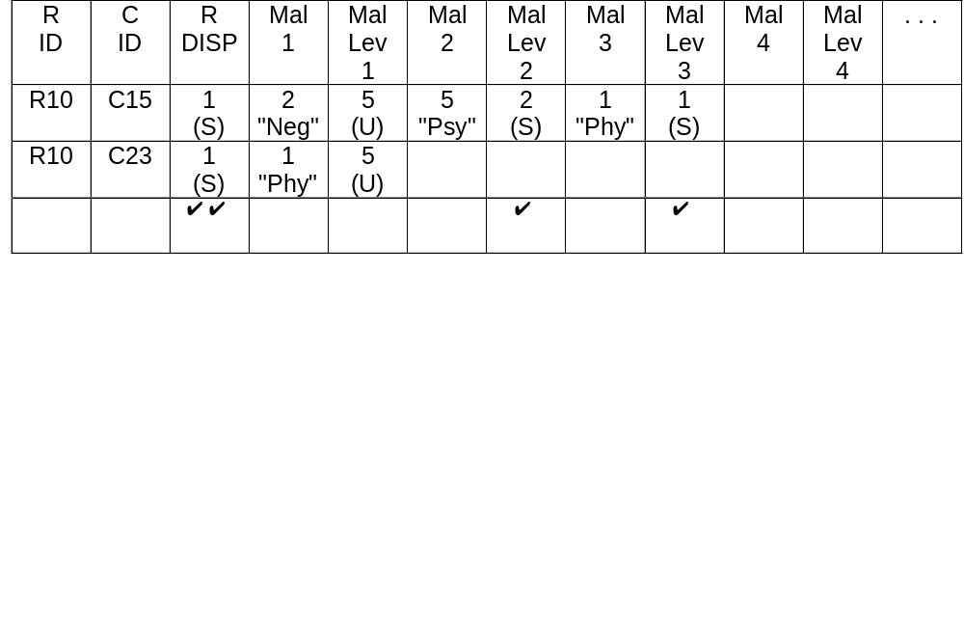
Maltreatment/Disposition Example
Either of the (S) Maltreatment Levels
forced the Report Disposition to (S)

Slide 30
So . . .
Report Disposition is determined by the values of the four Maltreatment Levels for ALL of the children (records) in the Report
If ALL Maltreatment Levels for ALL of the children in a Report are Unsubstantiated (U), the Report Disposition is Unsubstantiated (U)
If ONE or MORE Maltreatment Levels are Substantiated (S) for AT LEAST ONE of the children in the Report, the Report Disposition is Substantiated (S)

Slide 31
And . . .
Alternate Response - Victim: Treated as Substantiated
Alternate Response - Non-Victim: Treated as Unsubstantiated.

Slide 32
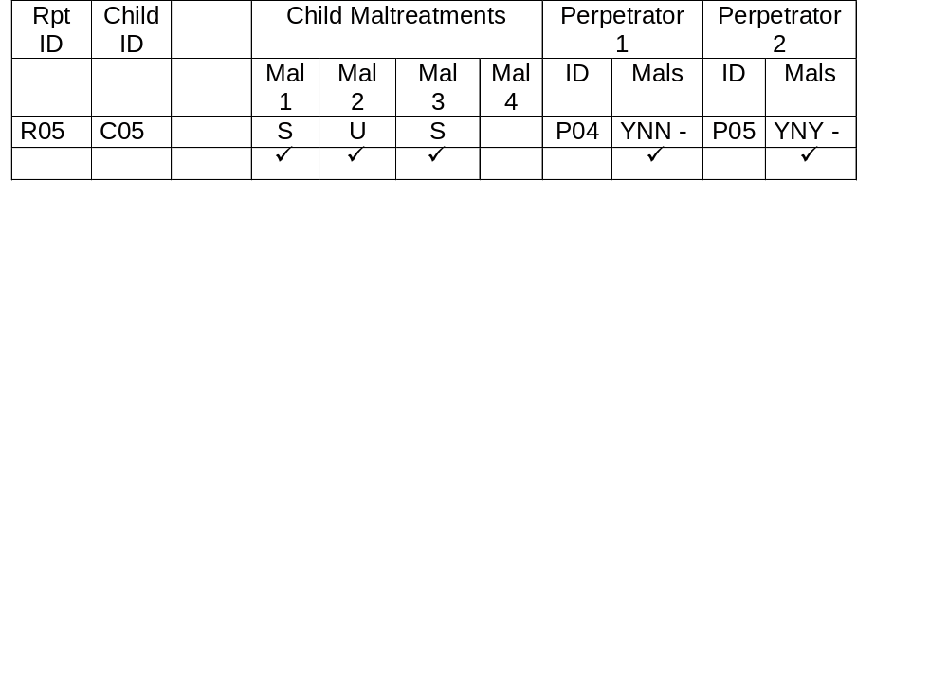
Associating Perpetrators and Maltreatments
Four Maltreatments per Child
Each Perpetrator may be Associated with Each Maltreatment per Child
Three Perpetrators are possible per Child.
Association can only be if Maltreatment is Substantiated.

Slide 33
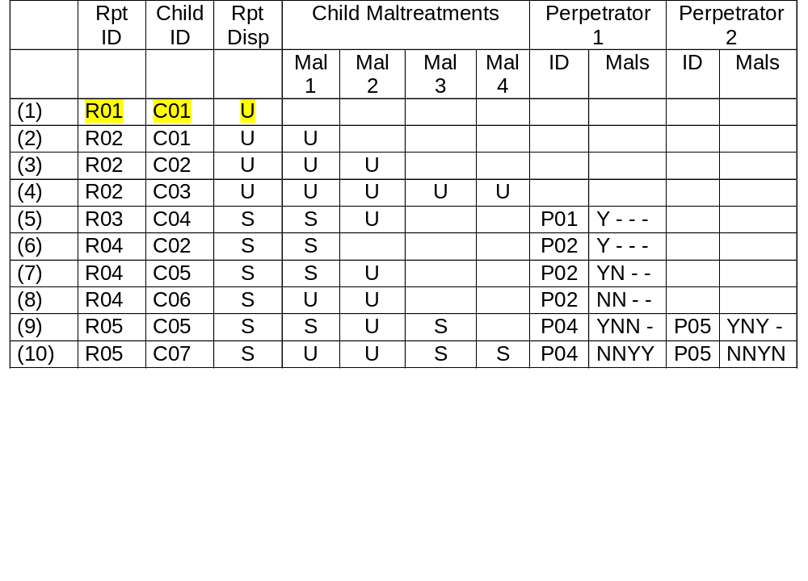
A Sample Child File

Slide 34
Units of Analysis
A Unit of Analysis is:
“What You Want To Count”
Like:
Reports
Children

Slide 35
Duplicated vs Unduplicated Counts
If the same child comes through an agency 25 times, the DUPLICATED Count is 25 children.
If the same child comes through an agency 25 times, the UNDUPLICATED Count is 1 child.

Slide 36
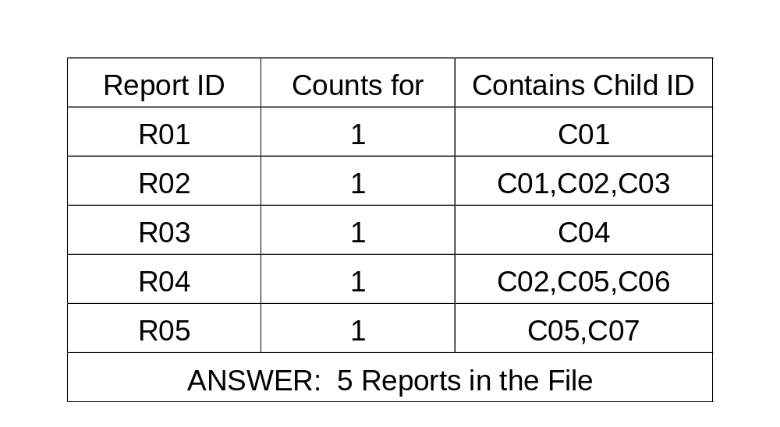
How Case Level Data Add Up
Question: How many Reports appear in the Child File?
Unit of Analysis: Unique Reports
Procedure: Frequency Count
Counts of Unique Report IDs

Slide 37
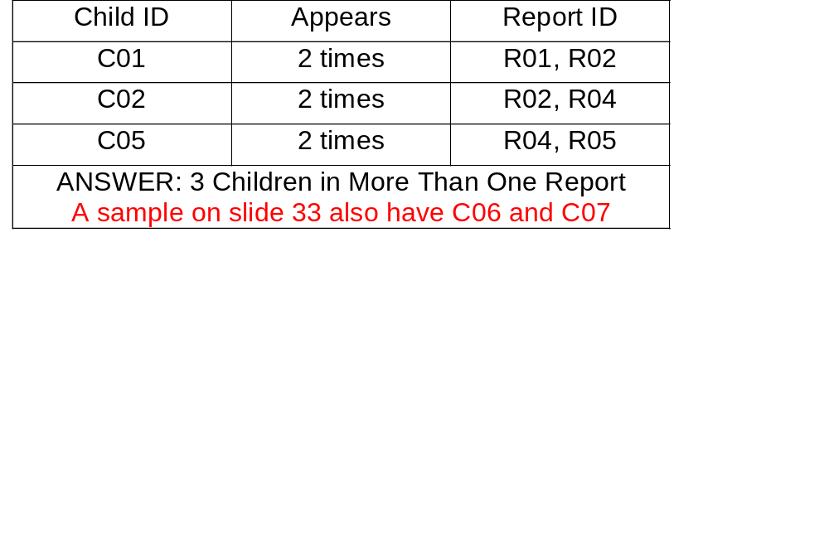
How Case Level Data Add Up
Question: How many Children appear in more than one Report?
Unit of Analysis: Unique Children
Procedure: Frequency Count
Counts of Child IDs

Slide 38
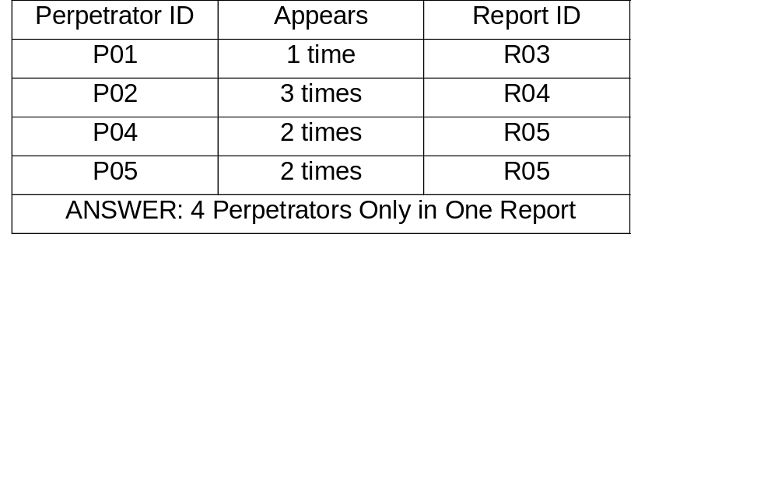
How Case Level Data Add Up
Question: How many Perpetrators appear only in one Report?
Unit of Analysis: Unique Perpetrators
Procedure: Frequency Count
Counts of Perpetrator IDs

Slide 39
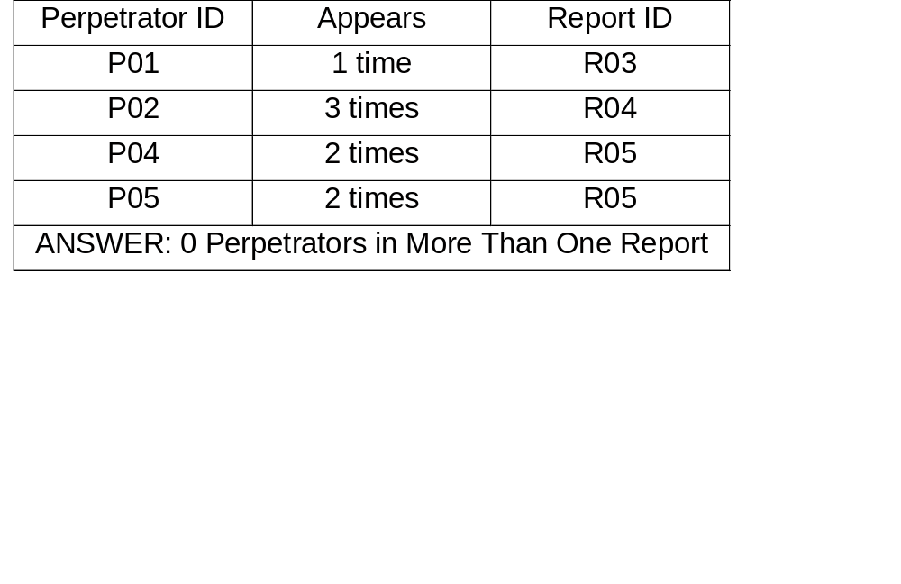
How Case Level Data Add Up
Question: How many Perpetrators appear in more than one Report?
Unit of Analysis: Unique Perpetrators
Procedure: Frequency Count
Counts of Perpetrator IDs

Slide 40
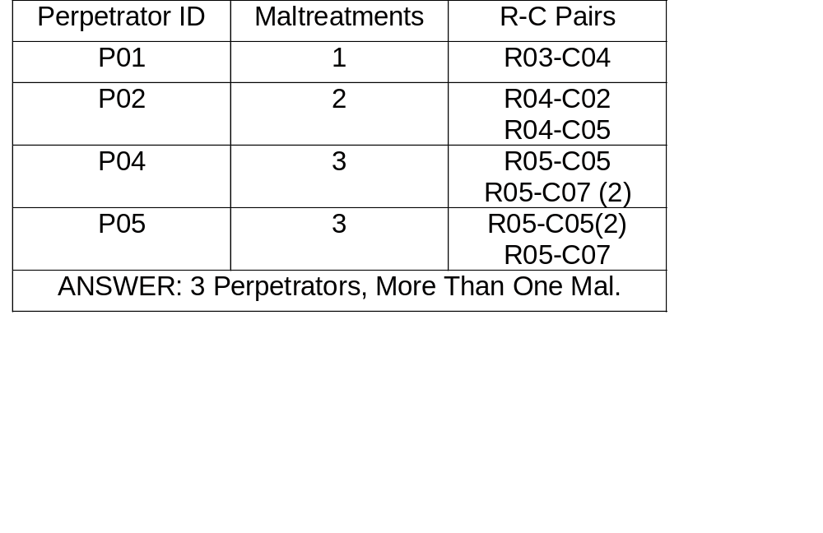
How Case Level Data Add Up
Question: How many Perpetrators are associated with more than one Maltreatment?
Unit of Analysis: Unique Perpetrators
Procedure: Frequency Count
Counts of Perpetrator IDs

Slide 41
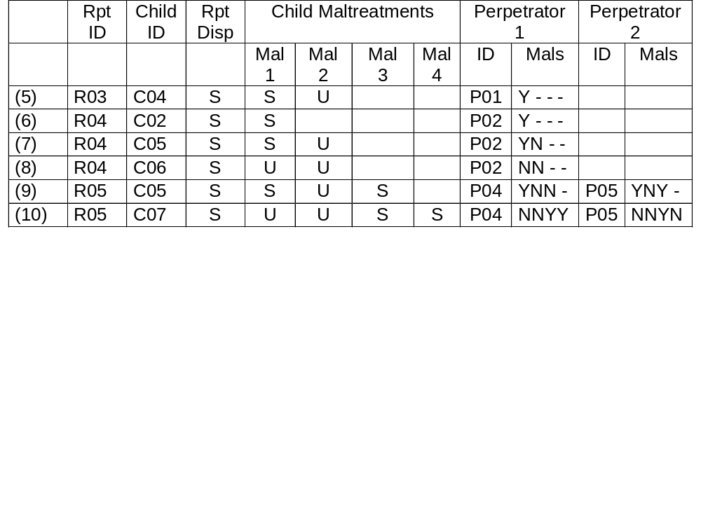
Records of Substantiated Reports with Perpetrators

Slide 42
How Case Level Data Add Up
Question: How many Child-Perpetrator Pairs exist?
Unit of Analysis: Unique Child-Perpetrator
Procedure: Frequency Count
Counts of Child-Perpetrator IDs

Slide 43
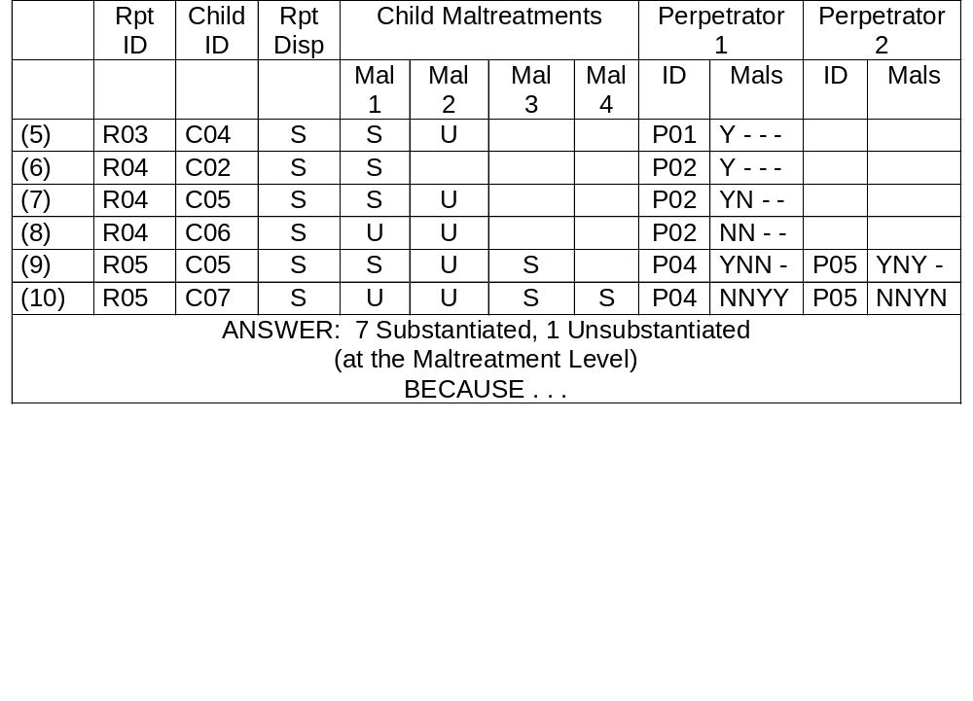
Child-Perpetrator Pairs

Slide 44
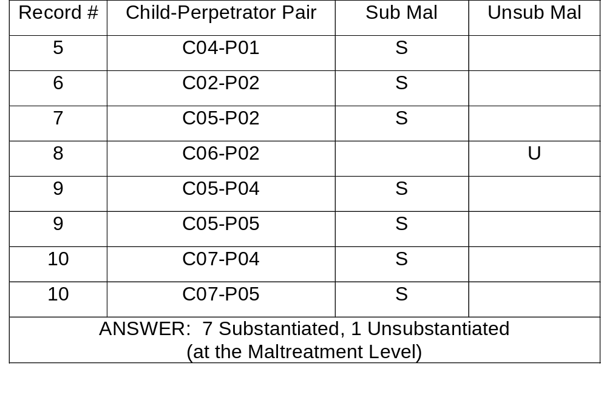
Child-Perpetrator Pairs (con’t.)

Slide 45
How Case Level Data Add Up
Question: How many R-C-P Triads exist in Substantiated Reports?
Unit of Analysis: Unique Report-Child-Perp
Procedure: Frequency Count
Counts of Report-Child-Perpetrator IDs

Slide 46
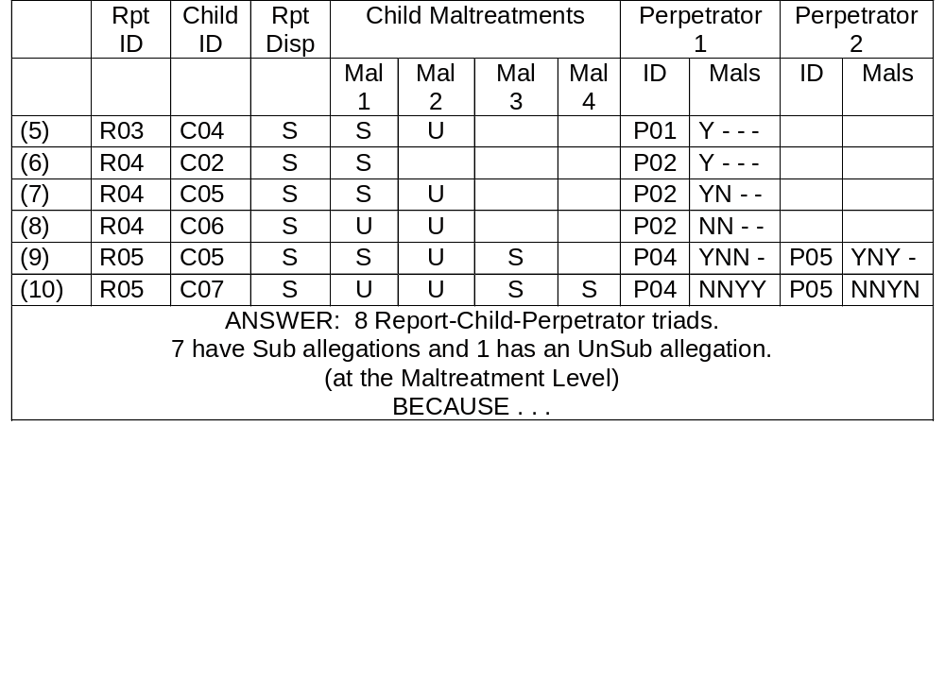
Report-Child-Perpetrator Triads

Slide 47
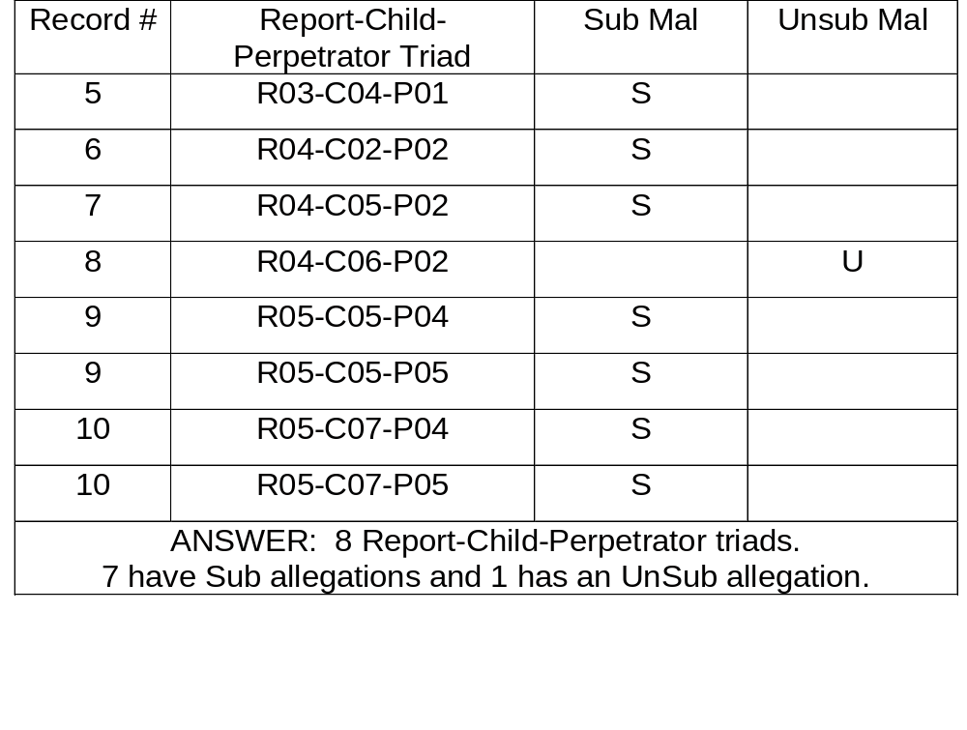
Report-Child-Perpetrator (con’t.)

Slide 48
State Data Validation
Child File Data is always validated by NCANDS Team
States may validate their Child File Data on State computers prior to data submission

Slide 49
The Mapping Process:
A Mapping Meeting at the State
To identify all of the State Data Elements needed for NCANDS (both Child and Agency Files) and define how each of these State Data Elements will map into the NCANDS data collection format
Refer to the
Guidelines and Procedures

Slide 50
The Mapping Meeting at the State
Chaired by the State Contact Person
Attended by State Programmatic Staff
Attended by State IT Staff
May be attended by NCANDS Team Member

Slide 51
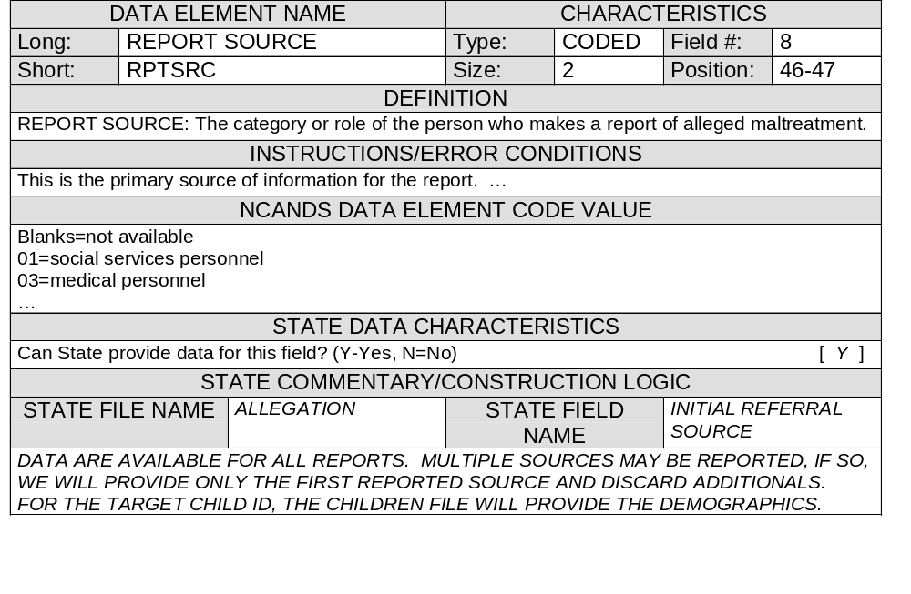
NCANDS CHILD FILE MAPPING FORM - Part 1

Slide 52
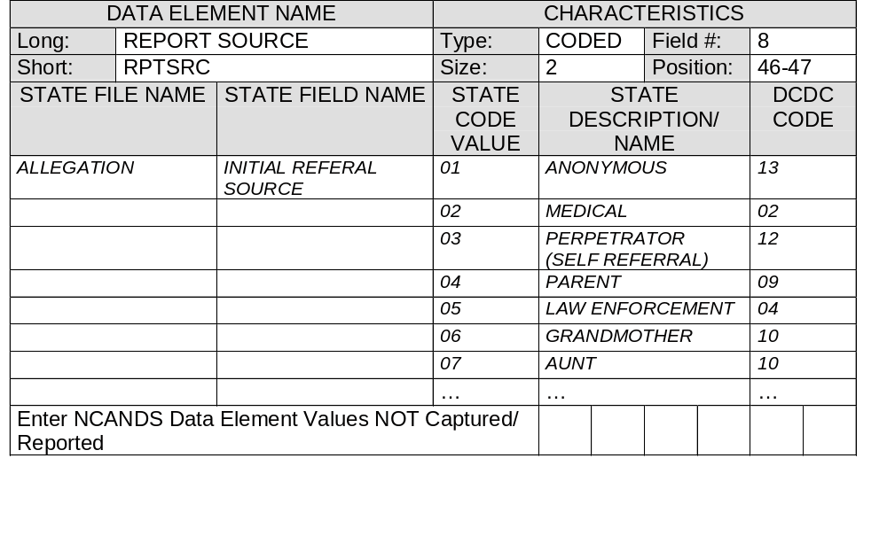
NCANDS CHILD FILE MAPPING FORM - Part 2

Slide 53
Common Child File Validation Rules
Identifier
Code Match
Date
Report Match
Child Match
Child Maltreatment
Duplicate Maltreatment

Slide 54
Common Validation Rules (con’t.)
Duplicate Maltreatment
Perpetrator Match
Perpetrator Substantiated Maltreatment
Occurrence in Time

Slide 55
Validation Error Information
Type 0 Error (Data Consistency)
Type 1 Error (Codes, etc.)
Type 2 Error (Remove the Record)
Type 3 Error (Remove the entire Report)
We now have types A, B, C, and D

Slide 56
Getting Started
Review Guidelines and Procedures
Obtain the Mapping Forms Files
State Mapping Meeting: Map State Data Elements to Child and Agency Data Formats
Consult with Technical Team on Mapping Issues
Technical Team reviews State Mapping
Discuss Plan for Submitting First Data

Slide 57
Participate in the Case Level Data
- The Child File -
To begin and to obtain technical assistance, call
John A. Gaudiosi
Social Science Statistician
(202) 205-8625
jgaudiosi@acf.hhs.gov
A liaison will be assigned to work with your State.

